Slide 1

DESIGN AND CONSTRUCTION SUN DRYING WET CLOTHES SYSTEM
Supervisor:
Mr. Nguyễn Đức Lợi
Team Members:
Hoàng Phi Long – SE62021 (Leader)
Nguyễn Đình Phong - SE61968
Trịnh Bình – SE61780

Slide 2
CONTENTS
Overview
Implementation
Conclusion
Demonstration

Slide 3

OVERVIEW

Slide 4


CURRENT SITUATION
Unexpected weather changes
Busy working environment

Slide 5
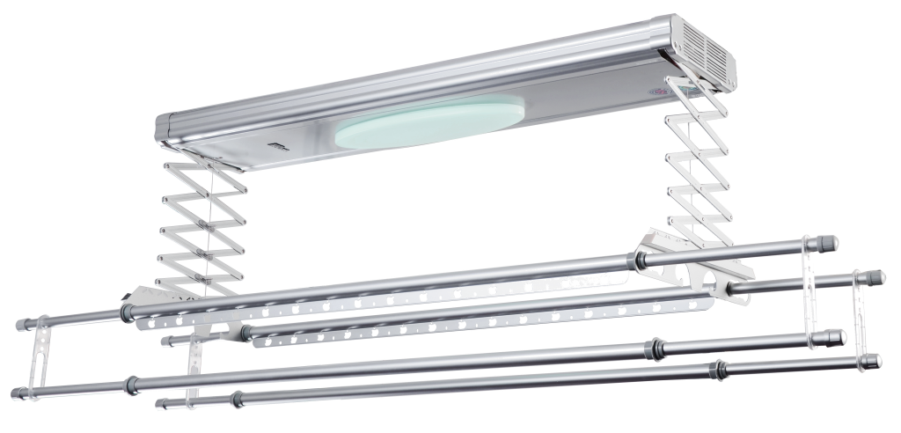
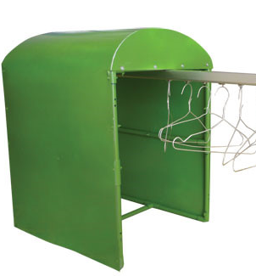
MARKET
Smart clothes dryer on market
Smart clothes dryer research in school

Slide 6
PROPOSED SOLUTION
DESIGN AND CONSTRUCTION SUN DRYING WET CLOTHES SYSTEM
Rain detection
Automatically dry and collect clothes according to weather and time
Dryer system
System can be controlled to collect and dry clothes by
RF Remote
Keypad
Mobile Application

Slide 7


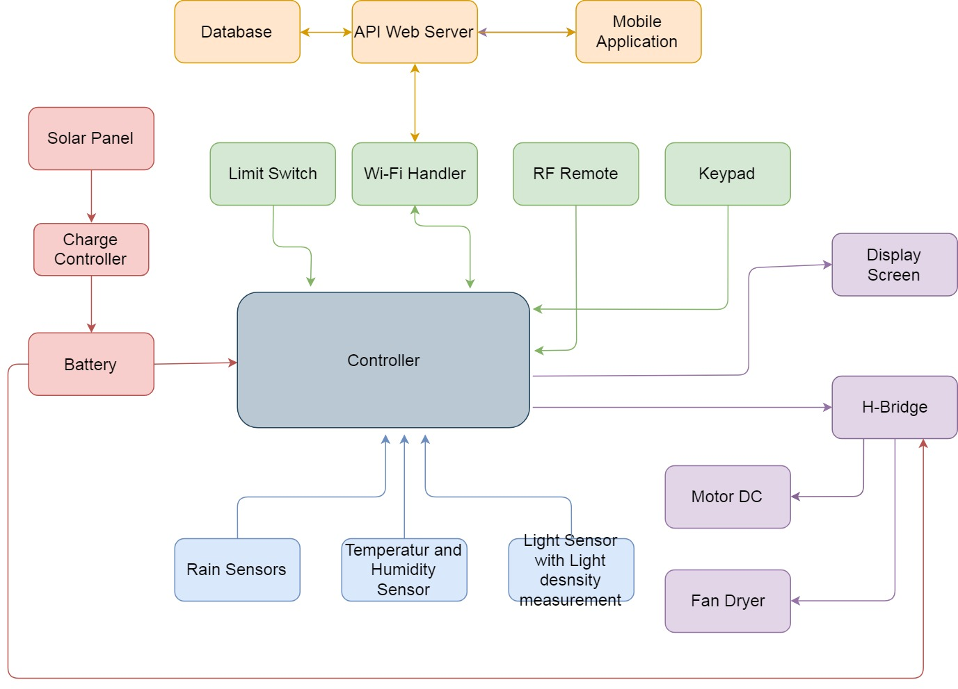

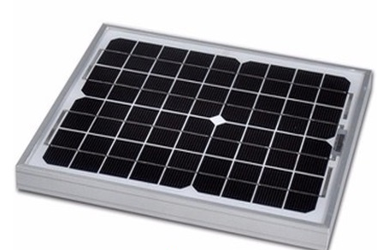
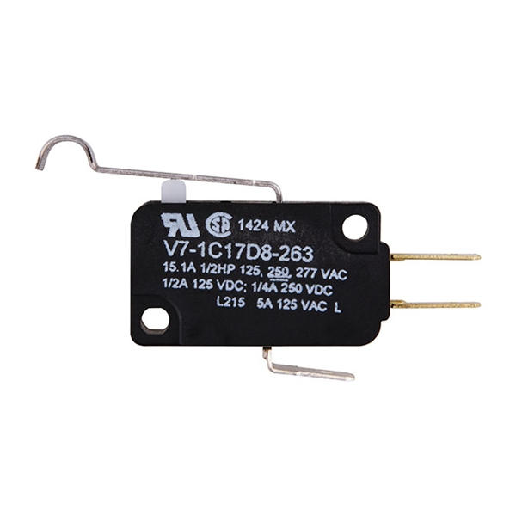
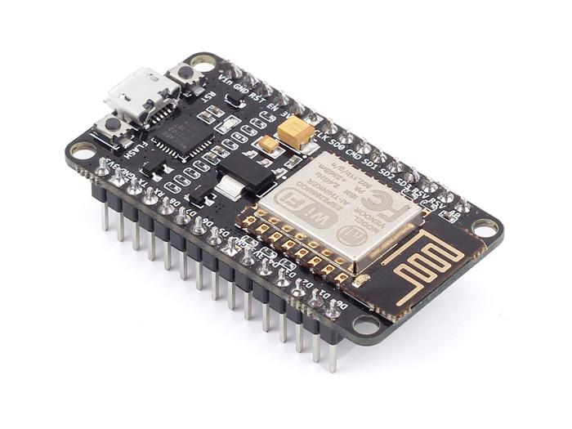
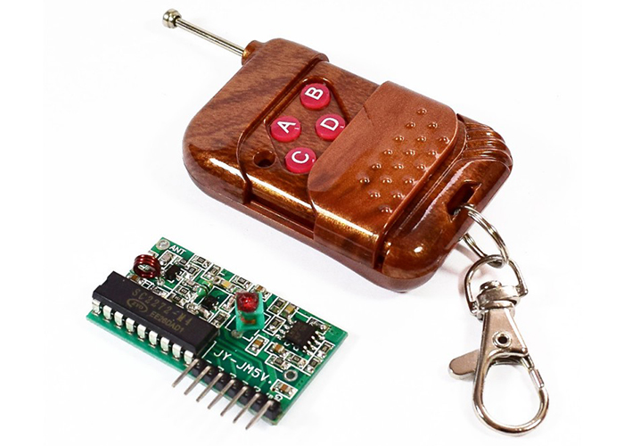
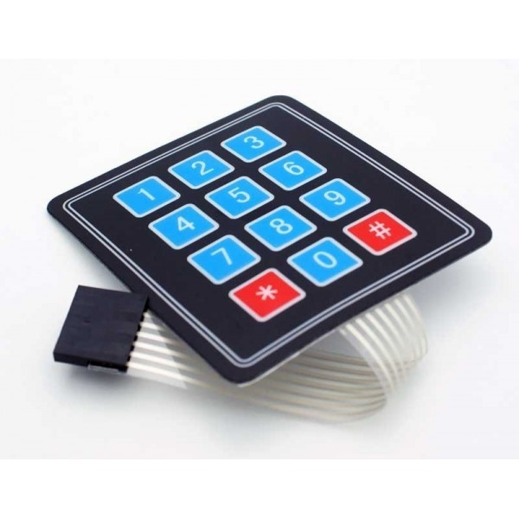
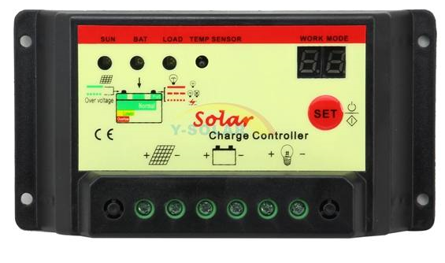
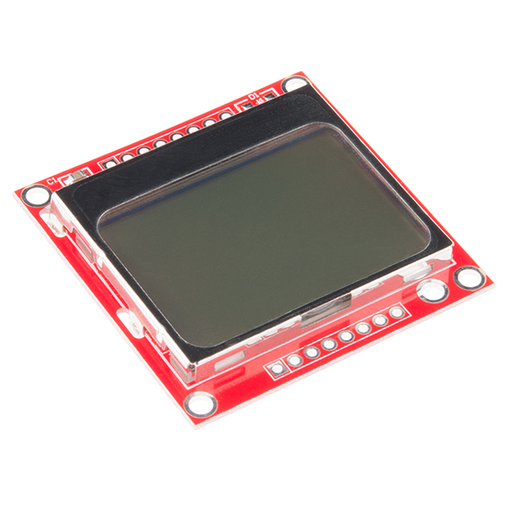
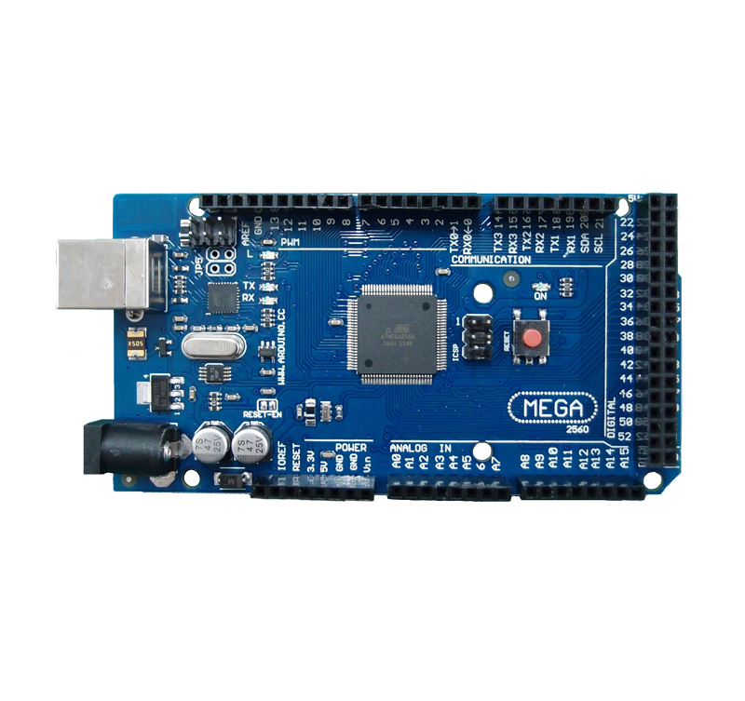

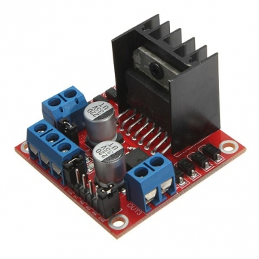
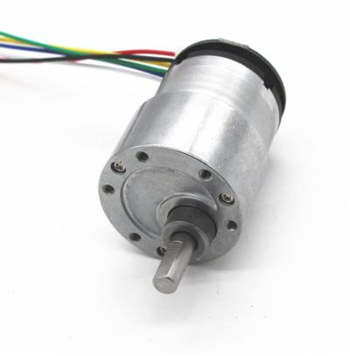
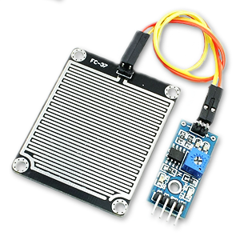
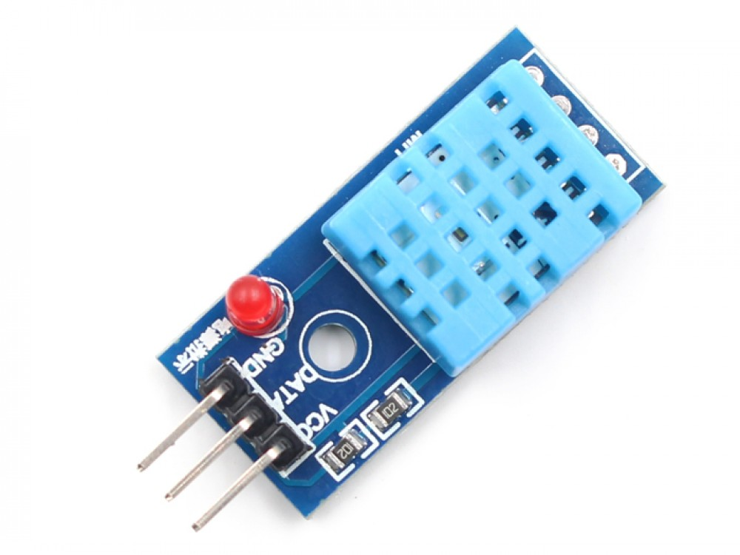
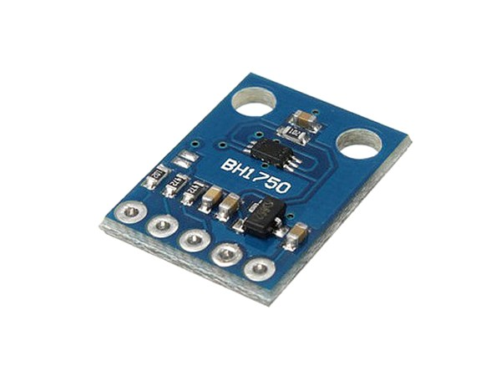

BLOCK DIAGRAM
Server and Mobile App block
Input control block
Energy Block
Load block
Sensors Block

Slide 8

IMPLEMENTATION

Slide 9
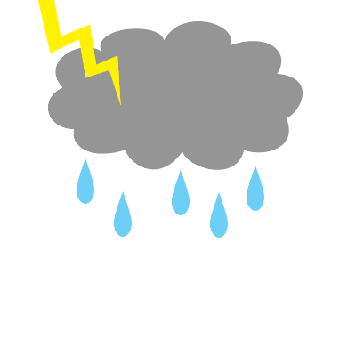






DESIGN
COLLECT CLOTHES WHEN RAIN STARTS
Limit Switch
Rain
sensor
Controller

Slide 10
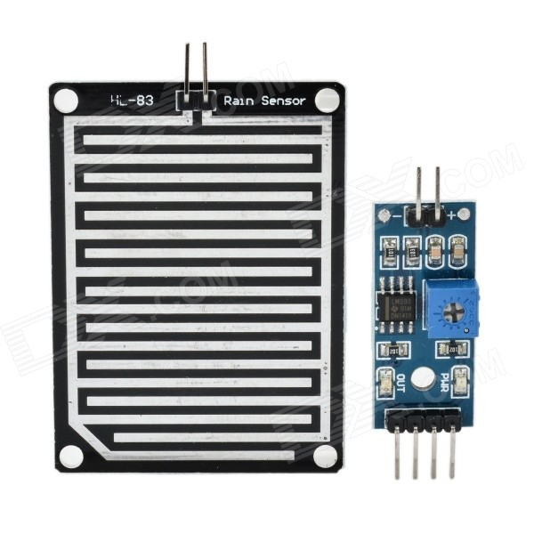
DESIGN
COLLECT CLOTHES WHEN RAIN ENDS
Limit Switch
Rain
sensor
Controller

Slide 11
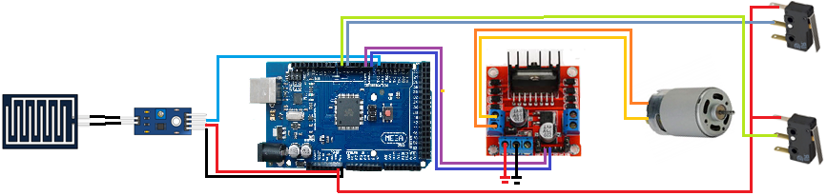
IMPLEMETATION
DRY/COLLECT CLOTHES WHEN RAIN STARTS/ENDS

Slide 12

DESIGN
COLLECT CLOTHES AT NIGHT
Limit Switch
Rain
sensor
Controller

Slide 13
DESIGN
DRY CLOTHES AT DAY
Limit Switch
Rain
sensor
Controller

Slide 14
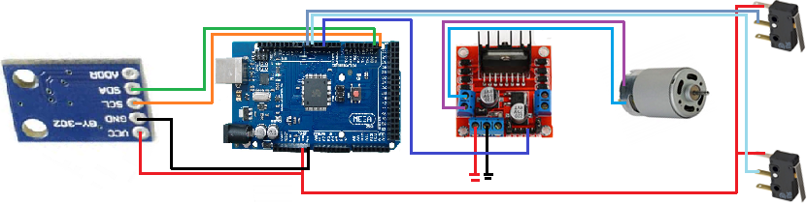
IMPLEMETATION
DRY/COLLECT CLOTHES AT DAY/NIGHT

Slide 15
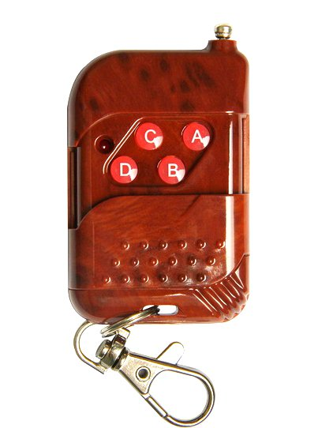
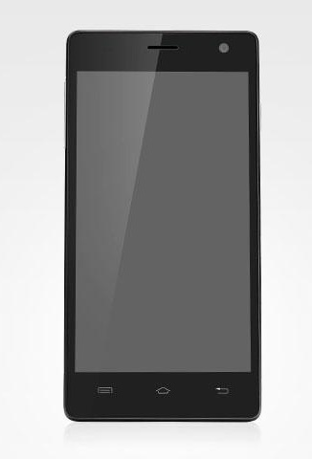
DESIGN
SYSTEM CONTROLLING
DC Motor
H-Bridge
Dryer
Controller
RF Remote
Keypad
Mobile Application

Slide 16
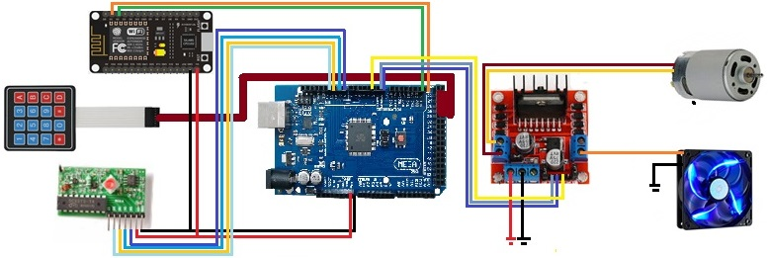
IMPLEMETATION
SYSTEM CONTROLLING

Slide 17
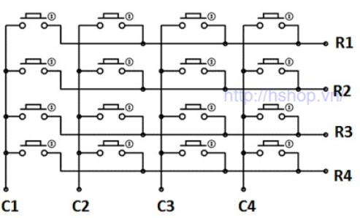
HOW DOES IT WORKS?
MATRIX KEYPAD
LOW
HIGH
HIGH
HIGH
HIGH
LOW
HIGH
HIGH
HIGH
Scan Column And Row

Slide 18
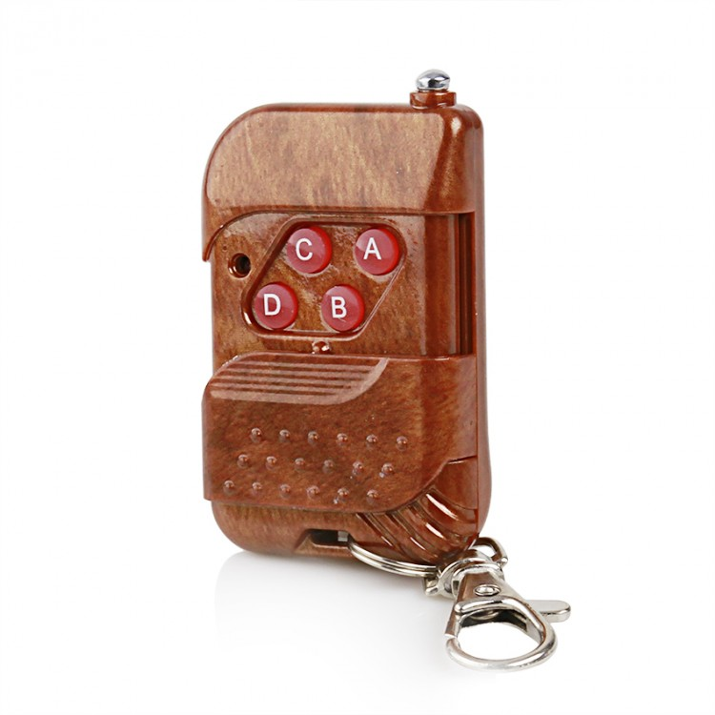
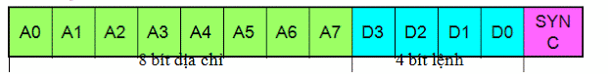
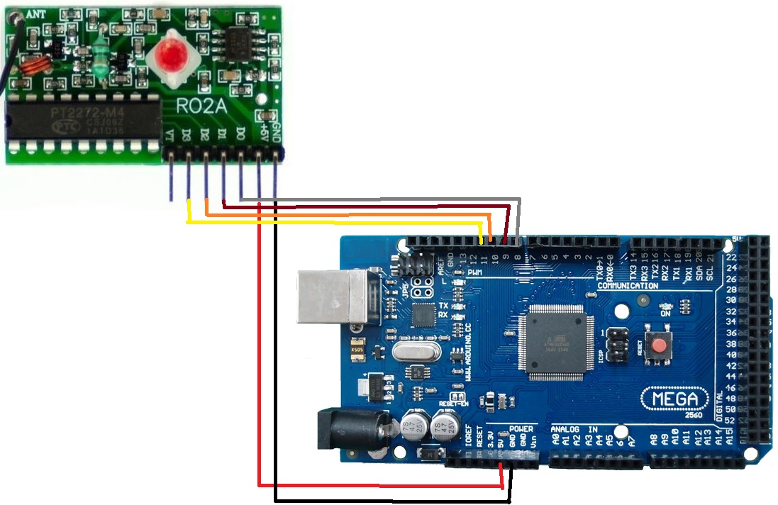
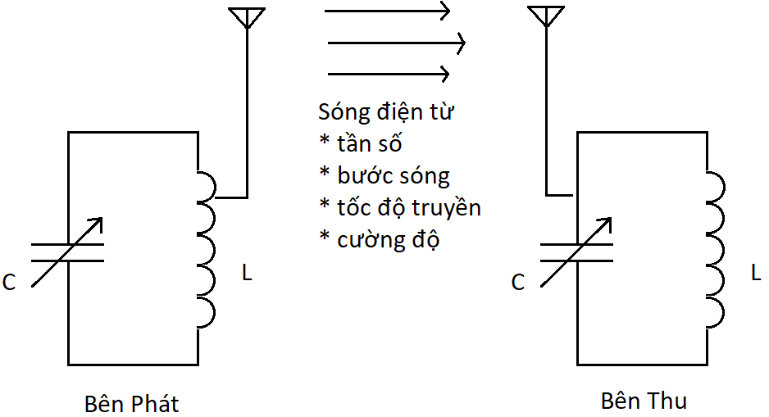
HOW DOES IT WORKS?
RF REMOTE
Notes:
Trong C: có điện trường Trong L: có từ trường

Slide 19

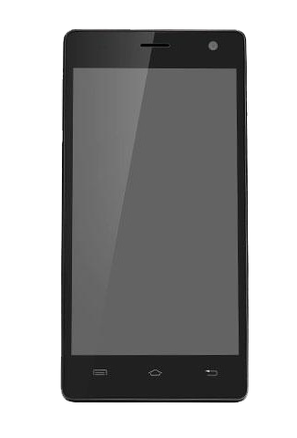

HOW DOES IT WORKS?
SYSTEM CONTROLLING FROM MOBILE APPLICATION
Message Action
Database
Mobile App
Server
Get Action
Module Wi-Fi
Controller

Slide 20
DESIGN
SHOW SYSTEM INFORMATION
Mobile Application
Server
LCD Screen
Controller
Module Wi-Fi
Light Sensor
Temperature Sensor
Humidity Sensor

Slide 21
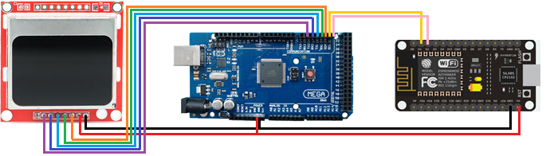
IMPLEMENTATION
SHOW SYSTEM INFORMATION

Slide 22
HOW DOES IT WORKS?
UPDATE SYSTEM INFORMATION TO MOBILE APPLICATION
Message Action
Database
Mobile App
Server
Get Action
Module Wi-Fi
Controller

Slide 23
HOW DOES IT WORKS?
UPDATE SYSTEM INFORMATION TO MOBILE APPLICATION
Update data request
Database
Mobile App
Server
System Data
Sensor Data
Module Wi-Fi
Controller
Sensors

Slide 24
DESIGN & IMPLEMENTATION
CHARGING USING SOLAR ENERGY
Solar Panel
Charger
Battery

Slide 25

CONCLUSION

Slide 26
TEST CASES

Slide 27
ADVANTAGES
Automatic drying system for rainy days
Having dryer system for use in rainy days
Multiple control options
Powered by solar energy
Possible to upgrade with extra options
Simple construction
Ability to handle 1000 requests per second

Slide 28
DISADVANTAGES
Inadequate rain detection with the detection not being able to when the rain has stopped
Unable to assess clothes dryness
Delayed control of the mobile application
Limited automatic control functions

Slide 29
FUTURE DIRECTIONS
Implement Hidden Markov Model (HMM) for rain forecasting
Implement a function to assess clothes dryness
Develop more options to control system (Web App, SMS, Infrared Signal, etc.)
Improve automatic control algorithm
Reduce delay between mobile application and system

Slide 30

DEMONSTRATION
Automatic clothes collecting
Control with RF Remote
Control with Keypad
Control with Mobile Application

Slide 31

Thank You!
Any questions?

